Slide 1
OO Programming
The detail of Java

Slide 2
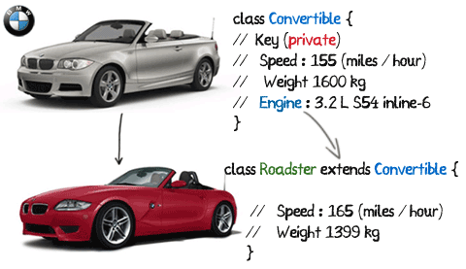
Inheritance
When to use:
Reusing attributes and Methods
Creating abstractions of concepts

Slide 3
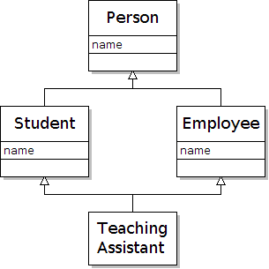
Inheritance Diamond Problem
How can we create a class that can be charged
and paid?
Charge()
Pay()
Notes:
Image credit: http://horstmann.com/sjsu/summer2012/unit9/diamond.png

Slide 4
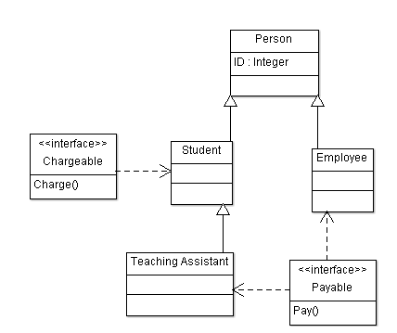
Interfaces
Standardizing a method across multiple classes

Slide 5
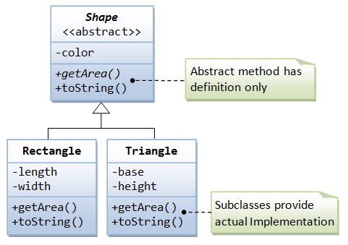
Abstract class
Problem: We want to create a super class that can’t be instantiated
Solution: Abstract class

Slide 6
Dynamic Method dispatching
Problem: Want to create multiple enemies with the same interface but have different implementations
Solution: Dynamic method Dispatching
See code example in the repo if you did not attend tutorial.

Slide 7
Runtime vs Compile time
When is Compile time? When is Runtime? What does it mean?
Mistakes happen when you are:
writing code
Compiling
Executing code
Understanding where in the cycle the error happens helps diagnose the issue.
Is there an example?
Yes, see the code on the repo if you did not attend the tutorial

Slide 8
Concept Questions
Will an IDE catch compile time errors?
Will an IDE catch runtime errors?
Is there a difference between an abstract class and an interface?

Slide 9
Deliverables
SRS Due Sunday FEB 15
Programming Assignment 1 due MARCH 4

Slide 10
References
Runtime vs compile time explanation: https://www.youtube.com/watch?v=QmvmZqpthbc
Dynamic method dispatching: https://www.youtube.com/watch?v=PK2mZ39AAzE

